Slide 1
Radiation Oncology Training
at the University of Toronto
Andrea Bezjak, Program Director
UTDRO Residency training program
Nov 2020

Slide 2
Outline of the Presentation
What is Radiation Oncology/What do Radiation Oncologists do
RO Residency Training at University of Toronto
What is the Application Process like

Slide 3
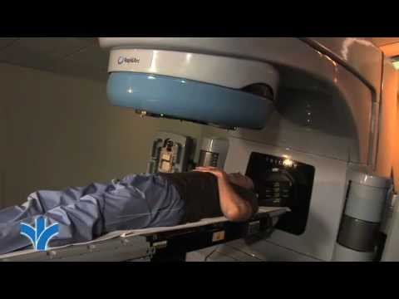
What is Radiation Oncology (Radiotherapy (RT))
Well established way to treat cancer
More than 100 yrs of history
Many ways in which RT helps cancer patients
cure (alone or in combination with chemo or surgery)
disease control
symptom palliation

Slide 4
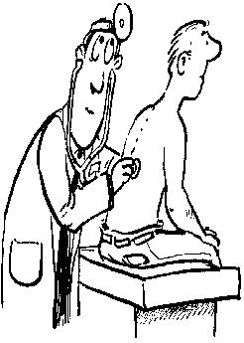
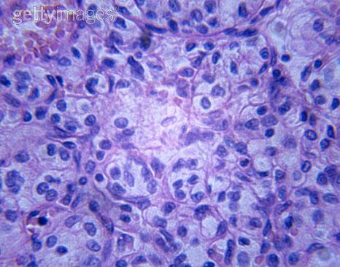
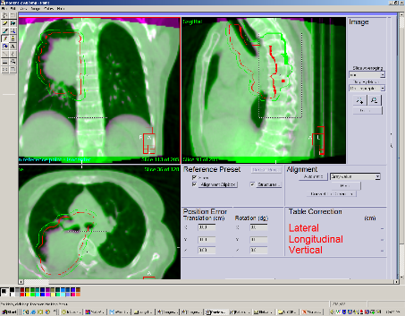
What is Radiation Oncology
Other cancer specialties:
Medical oncology
Surgery -surgical oncology or subspecialty – eg thoracic, urology, gynecology
Palliative care
(Family medicine with oncology focus)
RO is a clinical specialty based on knowledge of cancer, anatomy, biology, imaging and technology

Slide 5
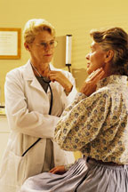
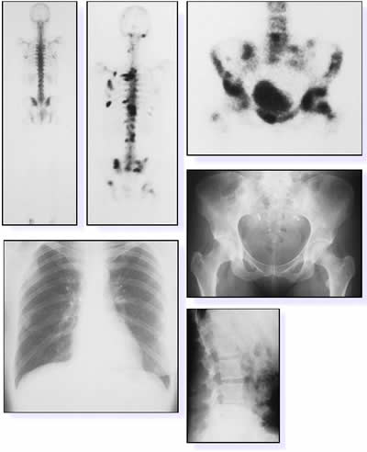
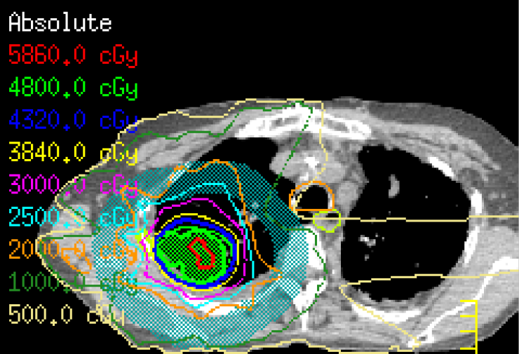
What do Radiation Oncologists (RO) Do?
Clinical care – mostly outpatient
consultations with newly diagnosed patients
decisions about best treatment
outlining the target for radiation (“contouring”)
reviewing the RT treatment plan
overseeing the course of RT
managing side-effects
following the patient after treatment

Slide 6
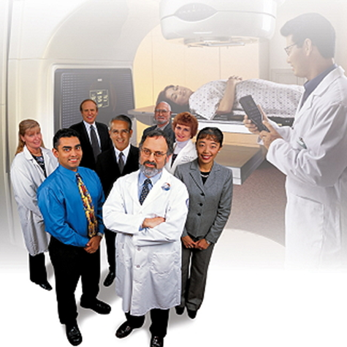
What do Radiation Oncologists Do?
Most RO focus their work on several cancer types (eg breast, lung, GU cancers…) altho they need to know about all
Some RO do procedures (eg brachytherapy for gyne ca, prostate)
They work in Cancer centers across Canada
Team work – physicists, therapists, nurses, medical oncologists, surgeons, etc

Slide 7
What do Radiation Oncologists Do?
Research/Scholarly Pursuits:
clinical
translational (lab to bedside and back)
technology research
health services research
education research
other
Teaching:
patients/families/public
trainees
other health care providers

Slide 8
Radiation Oncology Residency Program
Five year program
13 Residency programs across the country
https://www.royalcollege.ca/rcsite/documents/arps/rad-oncology-e
Competence by Design introduced in July 2019 across Canada (except Queens started in 2017)
Transition to Discipline (1-2 months)
Foundations of Discipline (10-15 months)
Core of Discipline (30-36 months)
Transition to Practice (10-12 months)

Slide 9
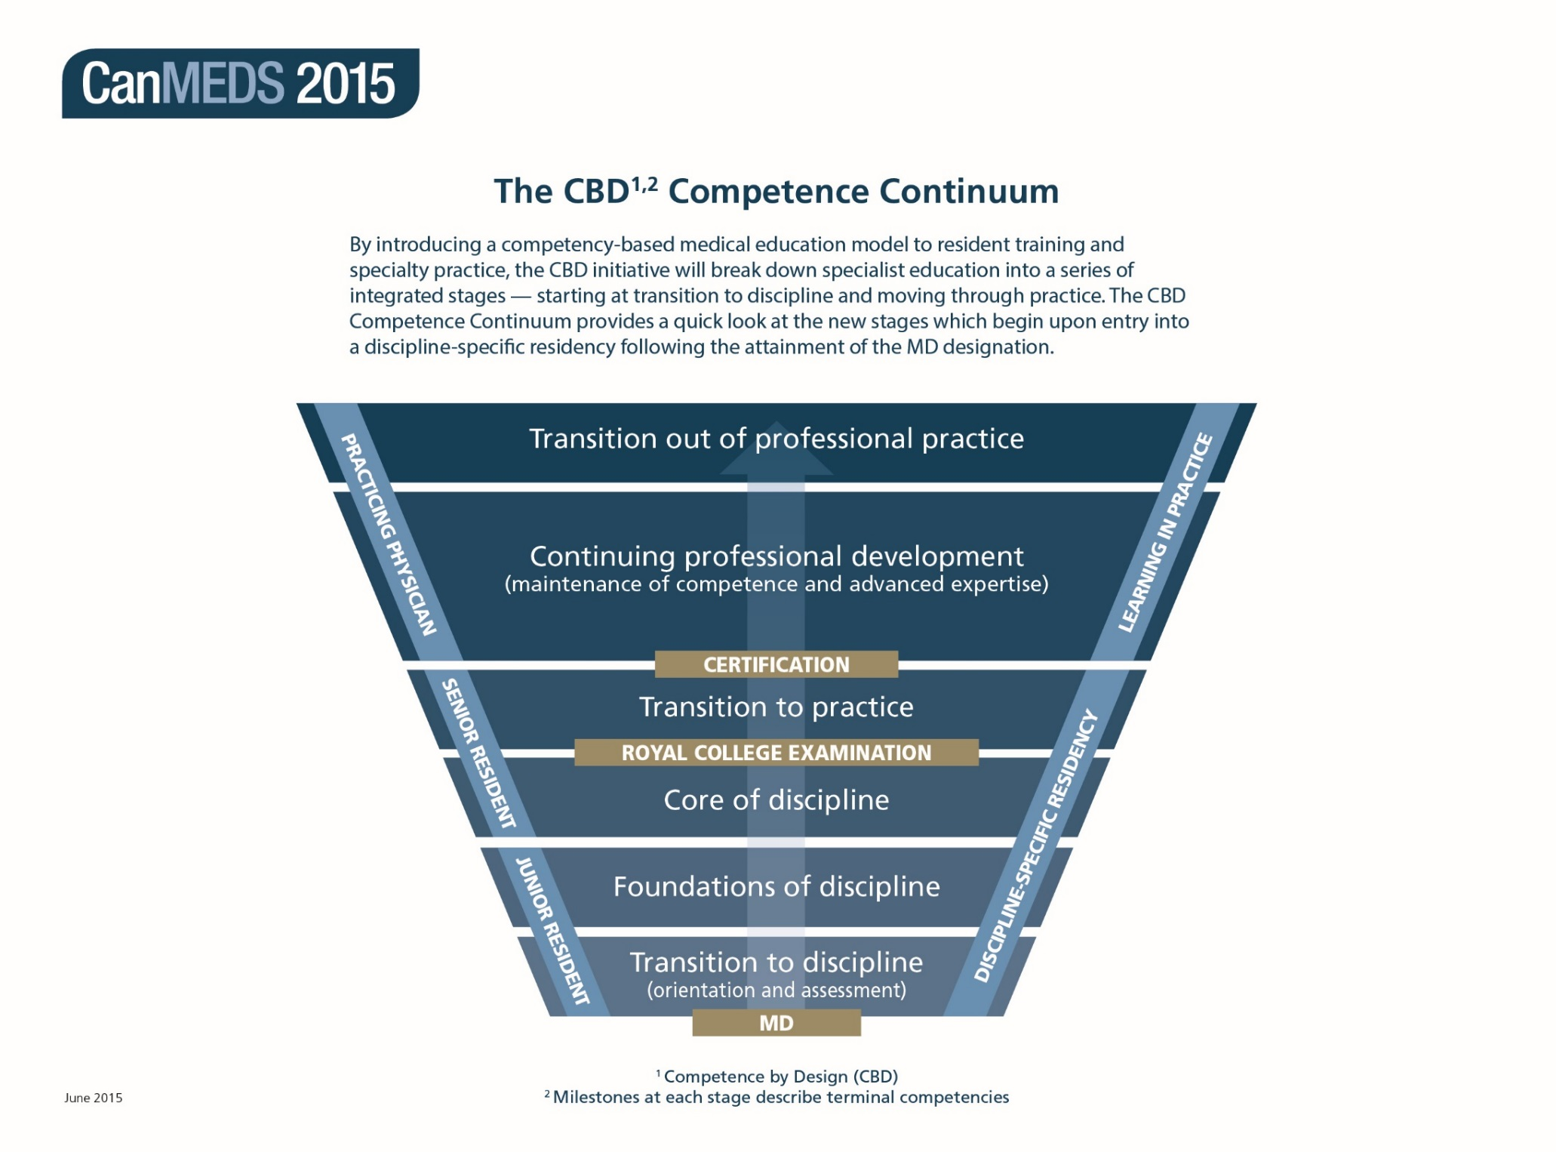

Slide 10
CBME Benefits
Increased assessment and ongoing feedback
Clearly defined targets for achieving competency (outcomes)
Training that focuses on resident’s personal development
Empowerment of residents in training
Increased preparation for independent practice
Carraccio C, Acad Med 2002
Carraccio CL, Acad Med2013
Leung WC. BMJ, 2002
Notes:
CBME → Outcomes-based approach to the design, implementation, assessment, and evaluation of a medical education program using an organizing framework of competencies.
Overall the combination of stages, milestones and EPAs will produce a number of benefits.
For learners, they will provide clear markers for teaching, learning and assessment.
They will enable learners and educators to
identify and follow an explicit, transparent path to achieve the required competencies;
adjust learning to individual needs and abilities;
easily identify (and provide evidence to demonstrate) areas where learners may be struggling and respond accordingly; and
regularly assess achievement and track learning progress.
The combination of milestones and EPAs will allow educators to examine performance at both the micro (when needed) and macro levels – providing a truly balanced view of a trainee’s abilities.
Furthermore, the connection between milestones and EPA will help make teaching and assessment more practical and manageable for busy supervisors.

Slide 11
Transition to Discipline at UT DRO
2 blocks (July, Aug)
Orientation, lectures, clinics, inpatient units
On call (with a “buddy” resident) at Princess Margaret Cancer Center (PMH) or Sunnybrook (Odette Cancer Center)
Focus on Performing and documenting a history and physical exam and Completing a patient handover

Slide 12
Foundations of Discipline at UTDRO (PGY1) 10 clinical blocks (off service) + 1 academic block
GIM
Urgent care
Surgical Oncology
ENT
Palliative care
Medical Oncology
Radiology
Foundations Academic

Slide 13
Foundations Training Experiences (PGY1)
Clinical Experiences:
Off service rotations
On call – for that service (eg surgery, GIM)
Or on call for RO (PMH, OCC) – with a buddy resident for the first ½ of the year – eg during palliative care, Urgent care, radiology

Slide 14
Foundations Training Experiences (PGY1)
Formal Instruction:
Medical physics
Radiobiology
Medical imaging
Pathology
Statistics & research
Presentation skills
Communication skills

Slide 15
Foundation EPAs
Assessing and managing patients with common medical and surgical problems in various settings
Identifying learning needs from clinical encounters and addressing one’s own gaps in knowledge and skills with guidance
Managing medical error and adverse events
Assessing and managing symptoms and complications in patients with a cancer diagnosis, in various settings

Slide 16
Core of Discipline at UTDRO – 36 mo (PGY2 -4)
Clinical Rotations (both at PMH and OCC)
On Call at the center where rotating
PMH = in house, OCC = from home
Call well below PARO guidelines
No clinical duties next day if in house call or called in after midnight
Academic Half Day every Friday AM for all residents
No clinical duties during AHD
Lectures and “treatment planning drill”
Applied physics teaching
Exams – OSCE, written clinical exams (PGY2, 3), Physics exams, Planning Exams (PGY3, 4)

Slide 17
Core at UTDRO (PGY2-3) 2-3 months for core clinical sites either at PMH or at OCC – with 2-4 attending RO
Breast Cancer
GU Cancers
Skin Cancer/Brain Metastases
Palliative Radiation
Lung Cancer
GI Cancers
Gyne Cancers
Head and Neck Cancers

Slide 18
Core at UTDRO (PGY4) 1-2 months for other clinical sites at PMH, OCC and community rotations
CNS
Lymphoma
Endocrine
Sarcoma
Pediatric Cancers
Community RO rotation
Elective Rotation
One-on-one RO Rotation

Slide 19
Core EPAs:
Performing and presenting initial assessments
Developing and communicating a management plan
Developing, evaluating and implementing radiation treatment plans
Managing patients with cancer throughout their treatment
Developing plans for follow-up, surveillance, and survivorship, for patients with cancer
Delivering scholarly teaching to a wide variety of audiences

Slide 20
The Royal College Exam
2-stage exam: written & oral
Written: Spring – end of Core (4th year)
Oral: Fall - end of Core/start of TTP (5th year)

Slide 21
Transition to Practice at UTDRO –PGY5 yr
Clinical Rotations as per resident choice
Longitudinal Clinic
Academic pursuits
Electives
TTP EPAs:
Providing radiation oncology consultation and management for patients with cancer or other indications for radiation therapy
Contributing to administrative and professional aspects of a radiation oncology practice
Executing a scholarly project relevant to Radiation Oncology

Slide 22
Application Process to RO Residency
13 programs across Canada – 21 Residency positions
July 2021 UTDRO = 3 CMG + 1 IMG (+ 1 visa trainee)
Goals of UTDRO Residency Program =
Train Future Academic Leaders
Attract Dynamic Enquiring Individuals who are enthusiastic about RO
Attract Residents who will contribute to advancing our profession and pursue scholarly enquiry
Expectation of excellence in all CanMEDS roles
Notes:
These goals are as stated in our internal documents

Slide 23
Requirements at UTDRO
A strong academic record
A proven interest in our specialty, demonstrated by experience in our specialty or related fields
References should attest to proficiency in clinical skills and provide comments on maturity, interpersonal skills, ability to work independently and potential for an academic career
Evidence of Research or Scholarly activity
Notes:
These are as listed on CARMS website

Slide 24
Comments re expectations at UTDRO
A strong academic record - we are not comparing between applicants but looking at what you did and how well (eg someone with a BSc background would not be compared to a MSc or PhD applicant)
A proven interest in our specialty, demonstrated by experience in our specialty or related fields –no expectations of electives in Toronto
References should attest to proficiency in clinical skills and provide comments on maturity, interpersonal skills, ability to work independently and potential for an academic career -references should be from faculty who got to know you the best – they don’t have to be RO faculty, more important that they describe your qualities and provide specifics/details
Evidence of Research or Scholarly activity –no expectation that it is in oncology area
Notes:
These are as listed on CARMS website

Slide 25
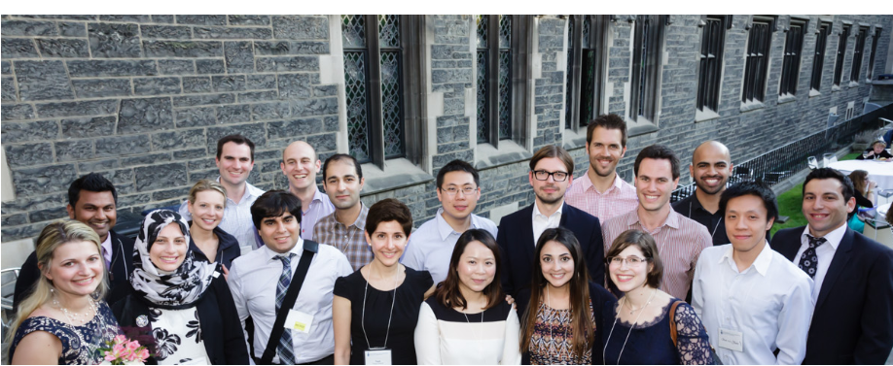
Residents at UTDRO
Currently 22 residents (photo is from graduation from a few years ago)
Great peer group
Lots to learn
Lots of research opportunities
Formal mentorship program
Wellness program
Chief resident (PGY4-5) and 2 Assistant Chief Residents (PGY3s)

Slide 26
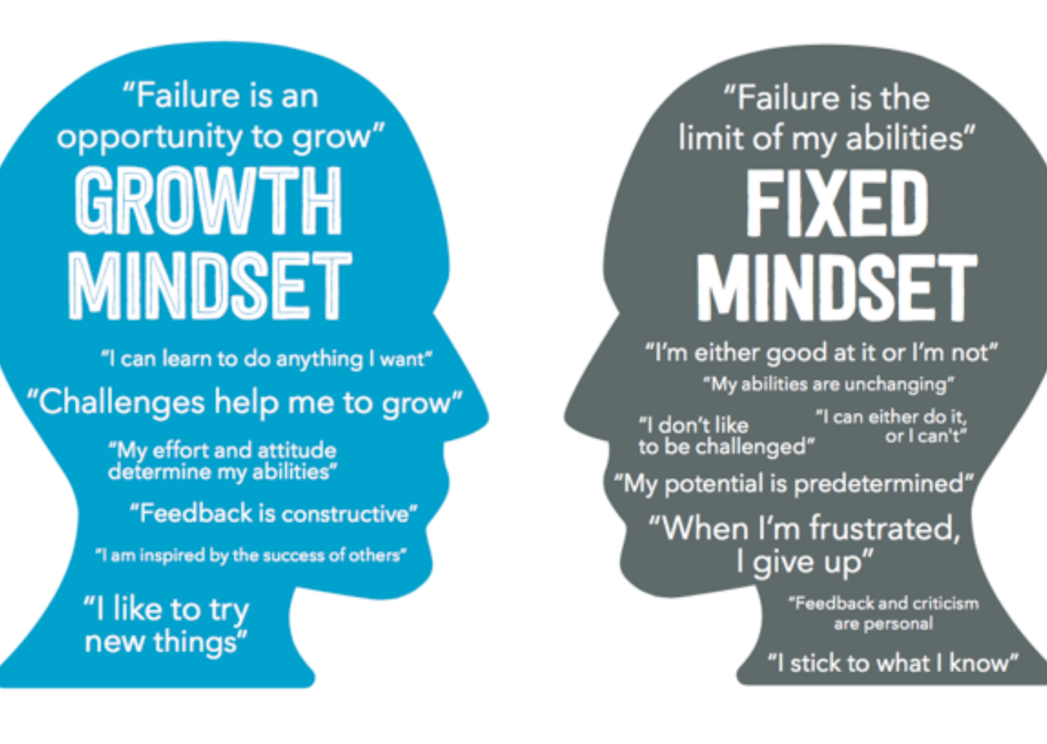
Importance of Growth Mindset

Slide 27
Contacts re UTDRO Residency program
Program Director Dr Andrea Bezjak
andrea.bezjak@rmp.uhn.ca
Program Coordinator Ms Catherine Wong
catherinek.wong@utoronto.ca
Chief Resident Dr Michael Tjong Michael.tjong@rmp.uhn.ca
Assistant Chief Residents
Dr Minha Lee minha.lee@rmp.uhn.ca
Dr Indu Voruganti indu.Voruganti@rmp.uhn.ca
https://www.radonc.utoronto.ca/radiation-oncology-residency

